Slide 1
OpenEmbedded and BitBake
Shadab Naseem
QIPL Kernel Team

Slide 2
OpenEmbedded
Software framework to create Linux distributions for embedded systems.
This may include bootloader, Linux, and applications.
have a set of metadata used to cross-compile, package and install software packages

Slide 3
OpenEmbedded
Single project tool like make are based on one Makefile or a closed set of inter-dependent makefiles
OpenEmbedded collects and manages an open set of largely independent build descriptions (package recipes) and builds them in proper order.

Slide 4
Objective of OpenEmbedded
Be self-contained
Be able to use external toolchains or build them
Easily cross-compile software, build packages or create root-ﬁlesystems
Easily add new features, machines, architectures, …

Slide 5
BitBake
BitBake is a generic task execution engine that allows shell and Python tasks to be run efficiently and in parallel while working within complex inter-task dependency constraints.
At the highest level, BitBake interprets metadata, decides what tasks are required to run, and executes those tasks.
OpenEmbedded takes this core and builds embedded Linux software stacks using a task-oriented approach.
For every task, BitBake creates a shell script on-the-fly and executes it

Slide 6
BitBake VS GNU Make
BitBake executes tasks according to provided metadata that builds up the tasks.
Metadata is stored in recipe (.bb), configuration (.conf), and class (.bbclass) files and provides BitBake with instructions on what tasks to run and the dependencies between those tasks.

Slide 7
BitBake VS GNU Make
BitBake includes a fetcher library for obtaining source code from various places such as source control systems or websites.
SRC_URI = ftp://ftp.berlios.de/pub/cdrecord/alpha/cdrtools-${PV}.tar.bz2
SRC_URI = "file://msmirqbalance/"

Slide 8
Concepts in BitBake
Recipes
Bitbake recipes(*.bb) are the most basic metadata files with the following info:
Descriptive information about the package
The version of the recipe
Existing Dependencies
Where the source code resides
Whether the source code requires any patches
How to compile the source code
Where on the target machine to install the package being compiled

Slide 9
Concepts in Bitbake
Configuration Files (*.conf)
define various configuration variables that govern the project's build process like machine configuration options, distribution configuration options, compiler tuning options, general common configuration options, and user configuration options.
Classes(*.bbclass)
contain information that is useful to share between metadata files.
base.bbclass is always included automatically for all recipes and classes.

Slide 10
Concepts in Bitbake
Layers
allow you to isolate different types of customizations from each other in a project.
to support a specific target machine. These types of customizations typically reside in a special layer, rather than a general layer, called a Board Specific Package (BSP) Layer.
Append files(*.bbappend)
To add or extend build information to an existing recipe file.
the append file and corresponding recipe file must use the same root filename. (e.g. formfactor_0.0.bb and formfactor_0.0.bbappend)
use the wildcard character (%) to allow for matching recipe names. busybox_1.21.%.bbappend for busybox_1.21.1.bb, busybox_1.21.2.bb busybox_1.21.3.bb

Slide 11
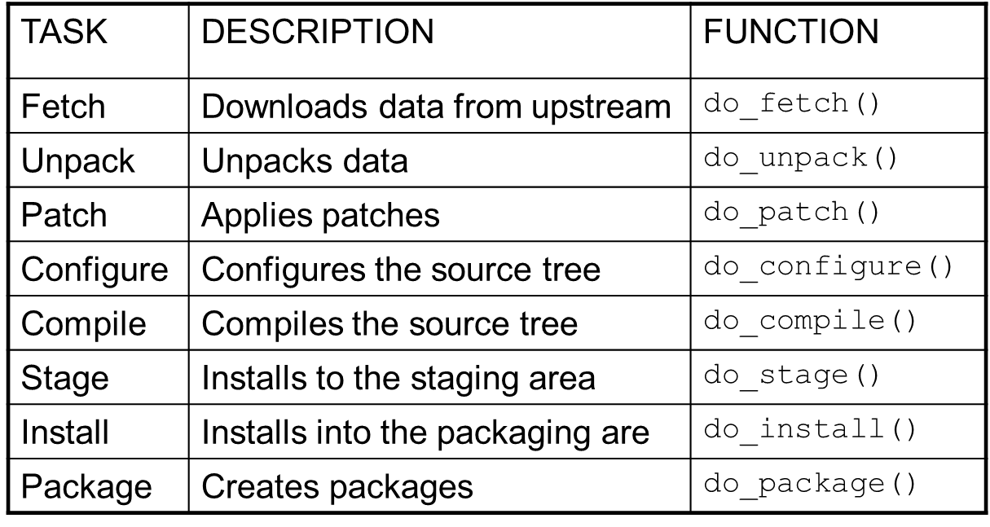
Main Task in BitBake

Slide 12
Autotools
OpenEmbedded uses Autotool to automate parts of the compilation process.
Autoconf
generates a configure script based on the contents of a configure.ac file which characterizes a particular body of source code.
Automake
takes its input as Makefile.am, and turns it into Makefile.in, which is used by the configure script to generate the file Makefile output.
also performs automatic dependency tracking

Slide 13
Process of making Images
Binary
Packages
BitBake
Recipes
Flash Image
Task Graph

Slide 14
Basic Steps in OE
To configure setup
cd poky ; source build/conf/set_bb_env.sh
To build whole package
build-8053-perf-image
To build only one project
MACHINE=mdm9607 bitbake virtual/kernel
To clean one project
MACHINE=mdm9607 bitbake -fc cleanall virtual/kernel
To rebuild a project
MACHINE=mdm9607 rebake virtual/kernel
To clean the whole package
buildclean

Slide 15
Summary
BitBake, a generic task executor
OpenEmbedded, the metadata for BitBake

Slide 16
Summary
OpenEmbedded: A metadata repository containing
Build classes
Machine configurations
Distribution policies
Recipes

Slide 17
Summary
BitBake: A simple tool to execute tasks on metadata
Parser to handle metadata
Package graph to handle package interdependencies
Task graph to handle task interdependencies
On-the-fly shell script generator

Slide 18
Reference
Open source
www.yoctoproject.org/docs/1.6/bitbake-user-manual/bitbake-user-manual.html
http://www.yoctoproject.org/docs/current/dev-manual/dev-manual.html
https://www.gnu.org/software/automake/manual/automake.html
www.denx.de/wiki/pub/ELDKHistory/DocumentationLinks/OpenEmbeddedv1.ppt
http://www.embeddedlinux.org.cn/OEManual/recipes_examples.html
Qualcomm Internal
http://qwiki.qualcomm.com/quic/LE_MDM/OE (http://go/oe )

Slide 19
Appendix
The OpenEmbedded-Core Project (OE-Core for short) resulted from the merge of the Yocto Project with OpenEmbedded.
https://www.linuxfoundation.org/news-media/announcements/2011/03/yocto-project-aligns-technology-openembedded-and-gains-corporate-co
Poky VS Oe-core
https://blogs.mentor.com/chrishallinan/blog/2012/04/13/yocto-versus-poky-versus-angstrom-etc/

Slide 20
Questions?

Slide 21
Use for Qualcomm Incorporated

